Slide 1

Ch.13. Advanced MySQL Programming
Siva R Jasthi
ICS325 – Internet Application Development
Information and Computer Sciences
Metropolitan State University

Slide 2
Outline
The LOAD DATA INFILE statement
Storage engines
Transactions
Stored Procedures
Stored Functions

Slide 3
LOAD DATA INFILE
You can easily load data from a plain text file into database tables.
By default,
Data fields in the file must be separated by tabs
The fields must be enclosed in single quotation marks
Each row must be separated by a newline (\n)
Any special characters must be escaped with a slash (\).
All the above characteristics are configurable with the various options of the LOAD statement.

Slide 4
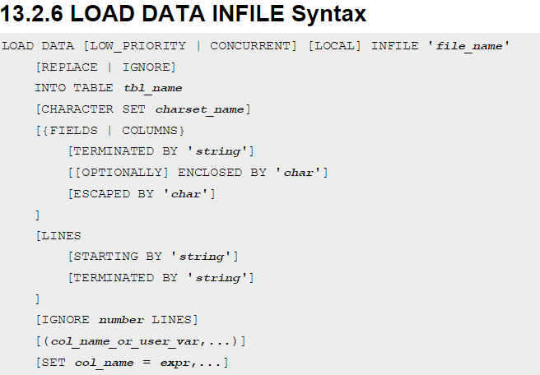
ONLINE MANUAL

Slide 5
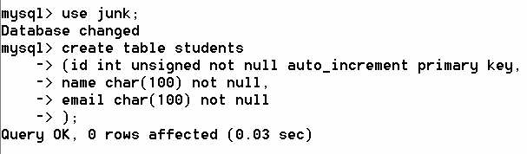
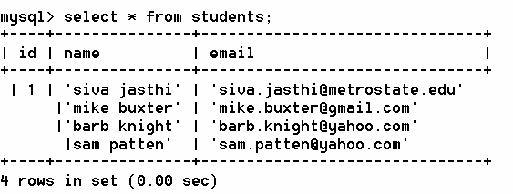
LOAD DATA INFILE (contd.)

Slide 6
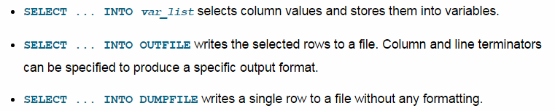
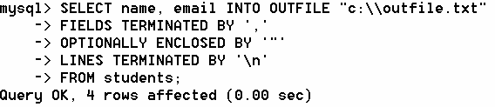
OUTFILE is a compliment of INFILE

Slide 7
Storage Engines in MySQL
Consider TechId, Name and Email as three columns.
And consider that there are many rows of such data.
This data can be stored in multiple formats.
Excel CSV Word Power point
Database XML HTML
Even if you push this data to a database, the database can also store the data in several ways.
For example, do you want the data stored in db tables visible only through db server.
Or is it possible to open the data file in notepad and inspect the data?
Do you need transactional support?
Or it is not worth the performance cost?
Do you have need to ARCHIVE the data frequently
Depending on your need, different storage mechanisms can be specified when creating the tables in MySQL

Slide 8
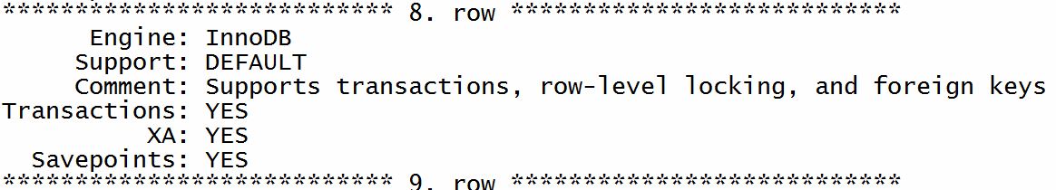
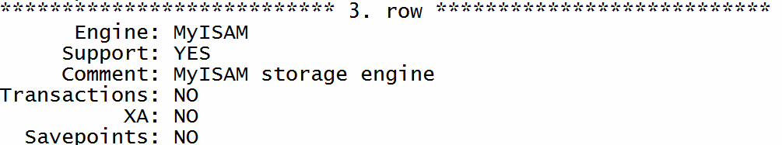

How many Storage Engines MySQL supports?
//default ; gives unformatted output
mysql> SHOW engines;
// \G option gives formatted output
mysql> SHOW engines \G

Slide 9
How many Storage Engines MySQL supports?
Engine: Name of the engine
Support: YES, NO, DEFAULT
Comment: Brief description about the engine
Transactions: are these supported? (YES/NO)
XA: is XA supported? (YES/NO)
Savepoints: Are savepoints supported? (YES/NO)
NOTE1. ISAM stands for Indexed Sequential Access Method, a method for indexing data for fast retrieval. MyISAM refers to ISAM for MySQL.
NOTE1: XA refers to an open standard for distributed transaction processing

Slide 10
MySQL 5.1 supported storage engines
MyISAM: The default MySQL storage engine and the one that is used the most in Web, data warehousing, and other application environments. MyISAM is supported in all MySQL configurations, and is the default storage engine unless you have configured MySQL to use a different one by default.
InnoDB: A transaction-safe (ACID compliant) storage engine for MySQL that has commit, rollback, and crash-recovery capabilities to protect user data. InnoDB row-level locking (without escalation to coarser granularity locks) and Oracle-style consistent nonlocking reads increase multi-user concurrency and performance. InnoDB stores user data in clustered indexes to reduce I/O for common queries based on primary keys. To maintain data integrity,InnoDB also supports FOREIGN KEY referential-integrity constraints.
Memory: Stores all data in RAM for extremely fast access in environments that require quick lookups of reference and other like data. This engine was formerly known as the HEAP engine.
Merge: Enables a MySQL DBA or developer to logically group a series of identical MyISAM tables and reference them as one object. Good for VLDB environments such as data warehousing.

Slide 11
MySQL 5.1 supported storage engines (Contd.)
Archive: Provides the perfect solution for storing and retrieving large amounts of seldom-referenced historical, archived, or security audit information.
Federated: Offers the ability to link separate MySQL servers to create one logical database from many physical servers. Very good for distributed or data mart environments.
NDB (also known as NDBCLUSTER)—This clustered database engine is particularly suited for applications that require the highest possible degree of uptime and availability.
CSV: The CSV storage engine stores data in text files using comma-separated values format. You can use the CSV engine to easily exchange data between other software and applications that can import and export in CSV format.
Blackhole: The Blackhole storage engine accepts but does not store data and retrievals always return an empty set. The functionality can be used in distributed database design where data is automatically replicated, but not stored locally.
Example: The Example storage engine is “stub” engine that does nothing. You can create tables with this engine, but no data can be stored in them or retrieved from them. The purpose of this engine is to serve as an example in the MySQL source code that illustrates how to begin writing new storage engines. As such, it is primarily of interest to developers.

Slide 12
Default storage engine
Starting from MySQL 5.5.5, the default storage engine for new tables is InnoDB.
This change applies to newly created tables that don't specify a storage engine with a clause such as ENGINE=MyISAM.
“SHOW engines” command will list engines supported by your MySQL server. And it will also indicate which of these storage engines is default.

Slide 13
Transactions (InnoDB)
A transaction is a query or set of queries guaranteed either to be completely executed on the database or not executed at all.
The database is therefore left in a consistent state whether or not the transaction completed.
Example: Consider the case where you are taking money from one account and transferring to another account.
What happens if there is power outage after the money is taken out but before the money is transferred to the second account?
In such cases, ensuring that the database server supports “transcations” is very important.
Committed: A transaction that has been permanently written to the database is said to be committed.
Rolled Back: A transaction that is not written to the database – so that the database is reset to the state it was in before the transaction began – is said to rolled back.

Slide 14
Transactions – ACID compliance.
Atomicity
Atomicity requires that each transaction be "all or nothing": if one part of the transaction fails, the entire transaction fails, and the database state is left unchanged. An atomic system must guarantee atomicity in each and every situation, including power failures, errors, and crashes. To the outside world, a committed transaction appears (by its effects on the database) to be indivisible ("atomic"), and an aborted transaction does not happen.
Consistency
The consistency property ensures that any transaction will bring the database from one valid state to another. Any data written to the database must be valid according to all defined rules, including constraints, cascades, triggers, and any combination thereof. This does not guarantee correctness of the transaction in all ways the application programmer might have wanted (that is the responsibility of application-level code) but merely that any programming errors cannot result in the violation of any defined rules

Slide 15
Transactions – ACID compliance (contd.)
Isolation
The isolation property ensures that the concurrent execution of transactions results in a system state that would be obtained if transactions were executed serially, i.e., one after the other. Providing isolation is the main goal of concurrency control. Depending on concurrency control method (i.e. if it uses strict - as opposed to relaxed - serializability), the effects of an incomplete transaction might not even be visible to another transaction.
Durability
Durability means that once a transaction has been committed, it will remain so, even in the event of power loss, crashes, or errors. In a relational database, for instance, once a group of SQL statements execute, the results need to be stored permanently (even if the database crashes immediately thereafter). To defend against power loss, transactions (or their effects) must be recorded in a non-volatile memory.

Slide 16
Handling Transactions in InnoDB
These statements provide control over use of transactions:
START TRANSACTION or BEGIN start a new transaction
COMMIT commits the current transaction, making its changes permanent
ROLLBACK rolls back the current transaction, canceling its changes
SET autocommit disables or enables the default autocommit mode for the current session
https://dev.mysql.com/doc/refman/5.7/en/commit.html

Slide 17
Stored Procedures in MySQL (Example)
A stored procedure contains a sequence of SQL commands stored in the database catalog so that it can be invoked later by a program
Stored procedures are declared using the following syntax:
Create Procedure <proc-name>
(param_spec₁, param_spec₂, …, param_spec_{n} )
begin
-- execution code
end;
where each param_spec is of the form:
[in | out | inout] <param_name> <param_type>
in mode: allows you to pass values into the procedure,
out mode: allows you to pass value back to the calling program
inout mode: allows you to pass values and get back updated values

Slide 18
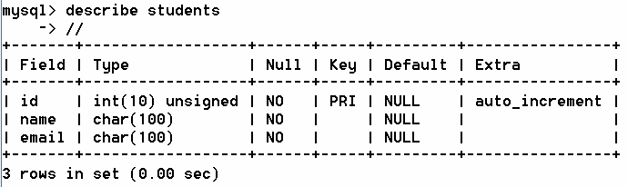
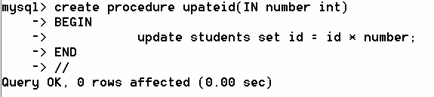
Stored Procedures in MySQL
mysql> delimiter //
mysql> delimiter ;

Slide 19

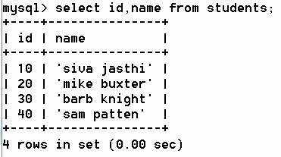
How do you call / invoke a stored procedure?
Calling a Procedure (IN parameter)
If the procedure is defined with any OUT parameter, then the it can be invoked with @ prefix indicating that the procedure need to store the output / return value in that paramter.
call total_order (@t);
select @t;

Slide 20
Defining a Stored Procedure - Steps
Step 1: delimiter //
Step 2: create procedure procedure_name (param1..n spec)
BEGIN
// all execution statements
END
//
Step 3: delimiter ;
Step 4: Call the stored procedure
All the stored procedures are managed by MySQL in Information_schema database. That is internal detail and we do not have to worry about it.

Slide 21
Defining a Function
Function is similar to Procedure with some differences.
[1] Function supports only INPUT parameters Similar to
Procedure | Function
create procedure | create function
Parameters need to be specified with IN or OUT or INOUT | No need to specify as all the parameters are IN
Return type is specified by parameter specification | Return type is specified by “return datatype” specification
call procedure(); | select function();

Slide 22
Defining a Function - Steps
Step 1: delimiter //
Step 2: create function function_name (param1, param_n) return datatype
BEGIN
// all execution statements
END
//
Step 3: delimiter ;
Step 4: Call the stored function

Slide 23
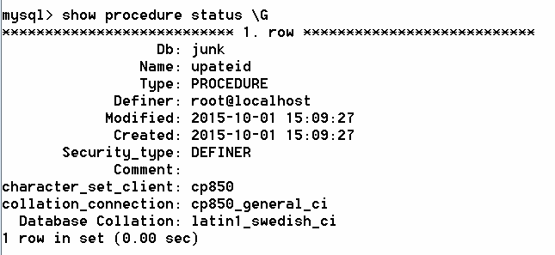
How do you know how many stored procedures are there in the db?

Slide 24
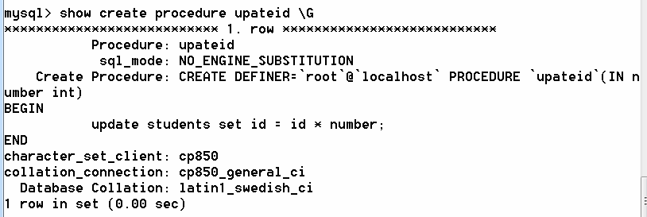
How do you know the definition of a stored procedure or function?
Show create procedure procedure_name;
Show create function function_name;

Slide 25
Stored Procedures and Functions
You can declare variables in stored procedures
You can use flow control statements (conditional IF-THEN-ELSE or loops such as WHILE and REPEAT)
MySQL also supports cursors in stored procedures.
A cursor is used to iterate through a set of rows returned by a query so that we can process each individual row.
Reference:
http://www.mysqltutorial.org/mysql-stored-procedure-tutorial.aspx

Slide 26
Summary
The basic query string syntax is good enough for majority of the applications.
Advanced MySQL programming through procedures and functions may be needed (a) to minimize the client-server trips and (b) to maximize the performance ( c) and to support reuse.
LOAD DATA INFILE is very handy to quickly upload the data into a database table. Use it for your assignments!

Slide 27
References
SQL Tutorial at W3 Schools
http://www.w3schools.com/sql/
PHP Manual on mysqli
http://php.net/manual/en/book.mysqli.php

